Slide 1
SITE Reliability Engineering Training phase 1 – Dec 14to 23rd
Topics
S/W. Development Models
[ Agile, DevOps, DevSecOps]
SRE
Virtual Box, Vagrant, NGINX [ Linux]
Container - Dockers

Slide 2
Content [Module 2] Dec 14th – 16th
Accessing Virtual Machines
Using VirtualBox
Installing/Setup – Vagrant
SSH & Other Commands
Welcome back to SRE -☺

Slide 3
Day 3 - Software Development Models
Using Virtual Machine, VirtualBox
Break – 11 AM to 11.15 AM
Hands on Using VMs
Questions & Answers
Assessment Time
Welcome Back to SRE -☺

Slide 4
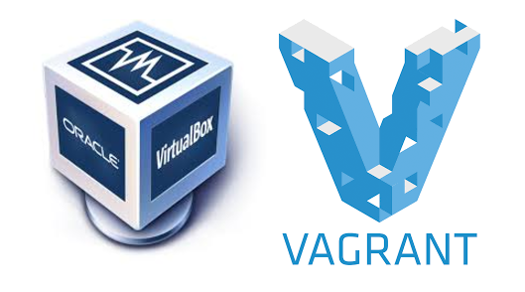
Installing VirtualBox and Vagrant on Windows VM
VirtualBox is basically inception for your computer. You can use VirtualBox to run entire sandboxed operating systems within your own computer.
Vagrant is software that is used to manage a development environment. Through the command line, you can grab any available OS, install it, configure it, run it, work inside of it, shut it down, and more.
Notes:
VirtualBox is probably a new term for most of you out there, but it is on the similar lines of VMware, docker and other vendors that offer operating-system level virtualization services for software development — or Container, to be generic! It is offered by the age-old Oracle.
VirtualBox usually goes hand-in-hand with Vagrant — an open-source software product by HashiCorp for building and maintaining portable virtual software development environments. So it acts as an agent that simplifies all the virtual environment configurations, meaning that developers can focus on developing and be more productive.
Using VirtualBox and Vagrant, you can simulate the production environment of your app or website. For example, if you're using Digital Ocean or AWS to run a Virtual Private Server (VPS) in the cloud running Ubuntu, PHP, and MySQL, you can install your local version to have all the same versions of that software, while keeping your own computer's software untouched. This can reduce and eliminate bugs and errors that result from trying to develop code for a production server on an environment that does not match.

Slide 5
Setting vagrant on virtual machine
Download and install Vagrant
$ mkdir mydirectory $ cd /mydirectory
We’ll install a Ubuntu 14.04 server as our VM
$ vagrant box add ubuntu/trusty64
$ vagrant init ubuntu/trusty64 - to initialize VM
$ vagrant up
$ vagrant ssh
Exit & vagrant halt [in case not able to access instance, install plugin]
$ vagrant plugin install vagrant-vbguest
$ vagrant reload
Notes:
`Vagrantfile` has been placed in this directory. You are now ready to `vagrant up` your first virtual environment! Please read the comments in the Vagrantfile as well as documentation on `vagrantup.com` for more information on using Vagrant.

Slide 6

Introduction to SRE
SLO, SLA and SLI

Slide 7
Site Reliability Engineering
Wikipedia
Google
Discipline that incorporates aspects of software engineering and applies them to infrastructure and operations problems. The main goals are to create scalable and highly reliable software systems
SRE is what you get when you treat operations as if it’s a software problem

Slide 8
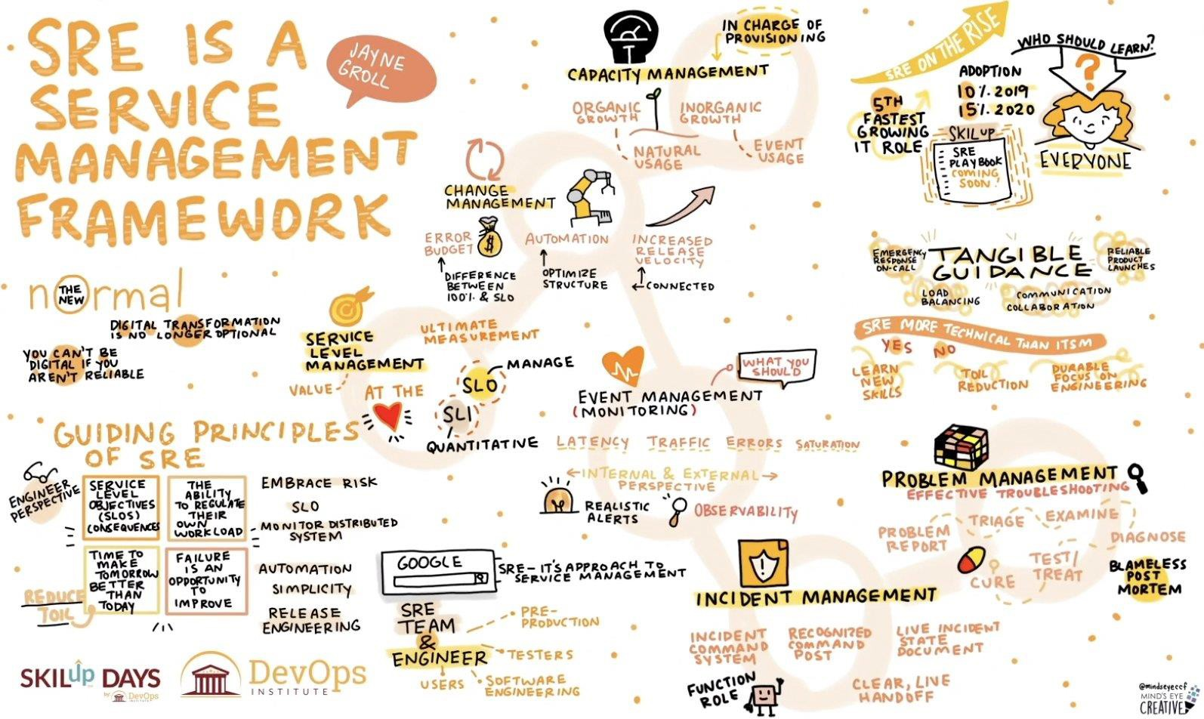

https://twitter.com/sureshgp/status/1273643362617159680/photo/1
Dr Ganesh Neelakanta Iyer

Slide 9

Whether you’re Google’s search engine, serving a billion active monthly users who interact with your service for free, or Salesforce, with 3.75 million paying subscribers, building a technology product means serving people.
https://www.atlassian.com/incident-management/kpis/sla-vs-slo-vs-sli

Slide 10
Hence, it is important for the companies to understand SLOs, SLIs and SLAs - three initialisms that represent the promises we make to our users, the internal objectives that help us keep those promises, and the trackable measurements that tell us how we’re doing.
https://www.atlassian.com/incident-management/kpis/sla-vs-slo-vs-sli

Slide 11
The goal
Get everybody—vendor and client alike—on the same page about system performance
How often will your systems be available?
How quickly will your team respond if the system goes down?
What kind of promises are you making about speed and functionality?
Users want to know—and so you need SLAs, SLOs, and SLIs
https://www.atlassian.com/incident-management/kpis/sla-vs-slo-vs-sli
Dr Ganesh Neelakanta Iyer
10

Slide 12
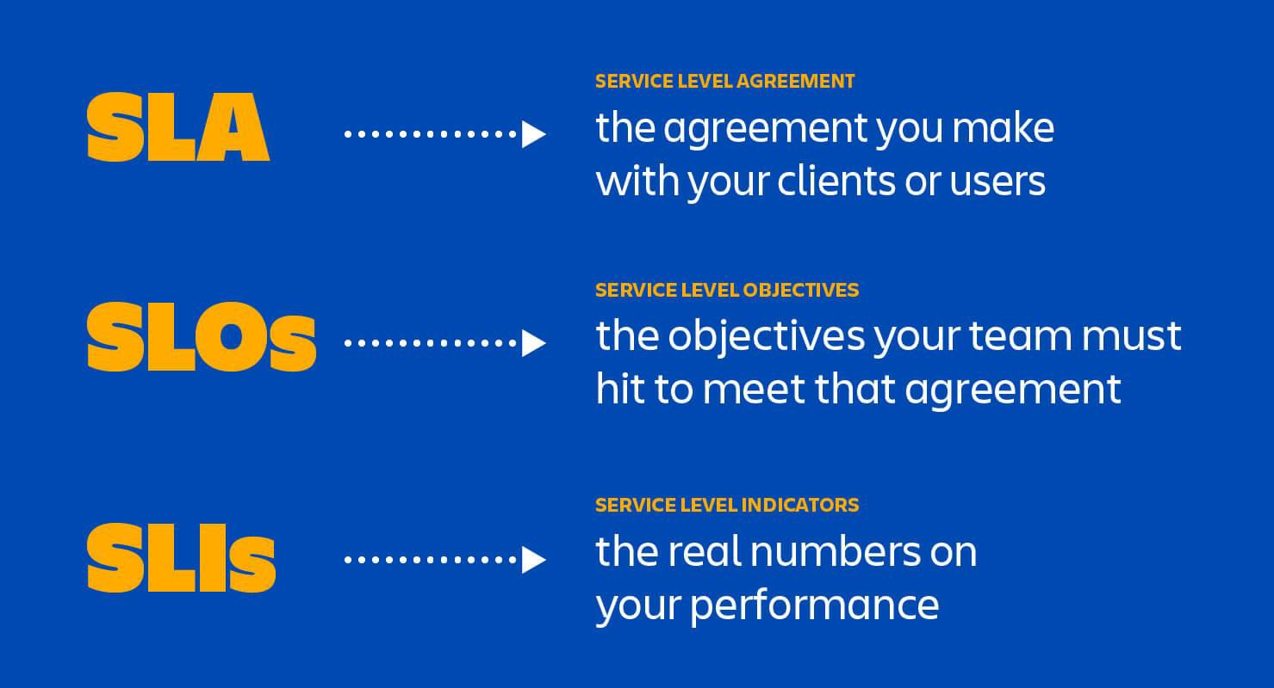
https://www.atlassian.com/incident-management/kpis/sla-vs-slo-vs-sli
Dr Ganesh Neelakanta Iyer 11

Slide 13
So what is the difference?
SLI
What we’ve chosen to measure progress towards our goal.
E.g., “Latency of a request.”
SLO
Stated objective of the SLI – what we’re trying to accomplish for either ourselves or the customer.
E.g., “99.5% of requests will be completed in 5ms.”
SLA
Contract explicitly stating the consequences of failing to achieve your defined SLOs.
E.g., “If 99% of your system requests aren’t completed in 5ms, you get a refund.”
https://www.circonus.com/2018/07/a
-guide-to-service-level-objectives/
Dr Ganesh Neelakanta Iyer
12

Slide 14
SLI
SLI are the parameters which indicates the successful transactions, requests served by the service over the predefined intervals of time
These parameters allows to measure much required performance and availability of the service
Measuring these parameters also enables to improve them gradually
Key Examples are:
Availability/Uptime of the service.
Number of successful transactions/requests.
Consistency and durability of the data
https://www.anshulpatel.in/post/sre_sli_sla_slo/
Dr Ganesh Neelakanta Iyer
14

Slide 15
SLO
SLO defines the acceptable downtime of the service
For multiple components of the service, there can be different parameters which defines the acceptable downtime
It is common pattern to start with low SLO and gradually increase it
Key Examples are:
Durability of disks should be 99.9%.
Availability of service should be 99.95%
Service should successfully serve 99.999% requests/transactions
https://www.anshulpatel.in/post/sre_sli_sla_slo/
Dr Ganesh Neelakanta Iyer
15

Slide 16
SLA
SLA defines the penalty that service provider should pay in an event of service unavailability for pre-defined period of time
Service provider should clearly define the failure factors for which they will be accountable(Domain of responsibility)
Key Examples are:
Partial refund of service subscription fee.
Additional subscription time added for free
https://www.anshulpatel.in/post/sre_sli_sla_slo/
Dr Ganesh Neelakanta Iyer
16

Slide 17

Error Budget

Slide 18
Error Budget
SRE engineers verify the code quality of changes in the application by asking the development team to produce evidence via automated test results
SRE managers can fix SLOs to gauge the performance of changes in the application
They should set a threshold for permissible minimum application downtime, also known as Error Budget
If a downtime during any changes in the application is within the scale of the Error Budget, then SRE teams can approve it
If not, then the changes should be rolled back for improvements to fall within the Error Budget formula
https://dzone.com/articles/site-reliability-engineering-sre-101-with-devops-v

Slide 19
Error Budget
Error Budgets tend to bring balance between SRE and application development by mitigating risks
An Error Budget is unaffected until the system availability will fall within the SLO
The Error Budget can always be adjusted by managing the SLOs or enhancing the IT operability
The ultimate goal remains application reliability and scalability
https://dzone.com/articles/site-reliability-engineering-sre-101-with-devops-v

Slide 20
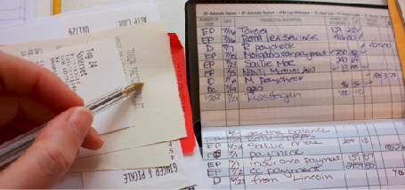
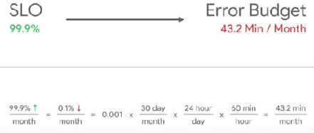
Error Budget
https://techbeacon.com/sites/default/files/styles/social/public/field/image/error-budget.jpg?itok=ogeA1BHH
http://blogs.shailendersingh.com/site-reliability-engineersre-defined/

Slide 21
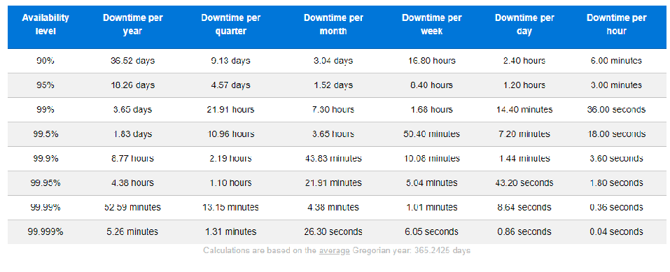
Error Budget - Availability cheat sheet
https://dzone.com/articles/site-reliability-engineering-sre-101-with-devops-v

Slide 22
Error Budget - Availability cheat sheet
Suppose the system availability is 95%. And, your SLO threshold is 80%.
Error Budget: 95%-80%= 15%
Availability | SLA/SLO Target | Error Budget | Error Budget per Month (30 days) | Error Budget per Quarter (90 days)
95% | 80% 15% |  | 108 hours | 324 hours
Error Budget/month: 108 hours. (At 5% downtime, per day downtime hours is
1.2 hours
Therefore for 15% it is 1.2*3 = 3.6. So for 30 days it will be 30*3.6 = 108 hours)
Error Budget/quarter: 108*3 = 324 hours.
https://dzone.com/articles/site-reliability-engineering-sre-101-with-devops-v

Slide 23
Where are you spending your error budget?
Do most of your errors happen when you’re doing binary releases?
Do something to make releases less frequent, less error-prone or lower-impact when there is an error
Are you seeing steady error spend coming from intermittent application failure, which adds up to the majority of your budget?
Do an RCA and plan to fix issues
https://cloudplatform.googleblog.com/2018/06/understanding-error-budget-overspend-cre-life-lessons.html
9

Slide 24
Where are you spending your error budget?
Major application failures, where most of your service goes down for many minutes due to configuration pushes, excessive load or queries-of-death?
Do effective post mortem and mitigate root causes
Dependency outside your control, such as a critical backend or your compute platform?
Talk to dependency or platform owner directly, showing them your SLI metrics and negotiating about how they can make their service more reliable
https://cloudplatform.googleblog.com/2018/06/understanding-error-budget-overspend-cre-life-lessons.html
10

